Slide 1
Big Data Overview

Slide 2
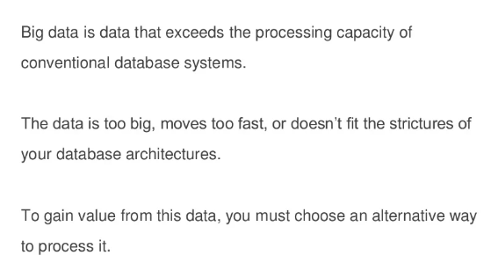
Introduction to Big Data

Slide 3
Big Data 4 Vs
Volume
Velocity
Variety
Veracity

Slide 4
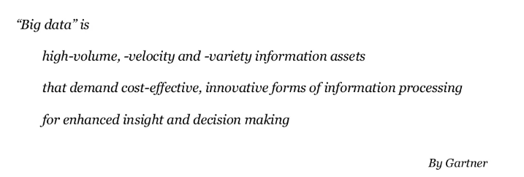
Big Data Definition

Slide 5
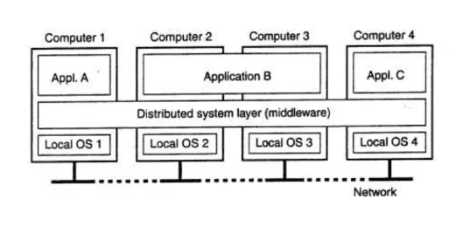
Distributed Systems

Slide 6
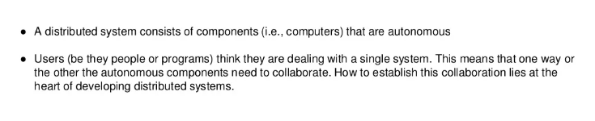
What is Distributed System

Slide 7
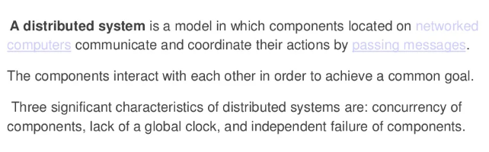
Distributed Systems Definition

Slide 8
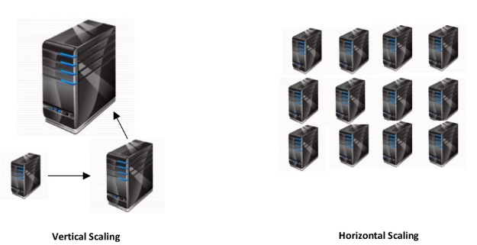
Horizontal Vs Vertical Scaling

Slide 9
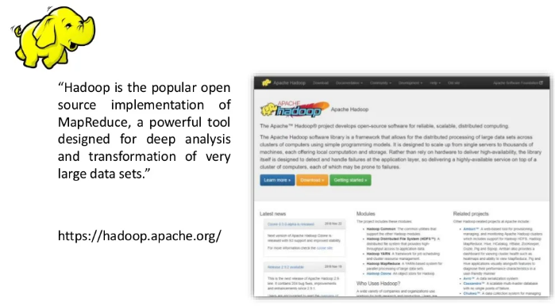
What is Hadoop

Slide 10
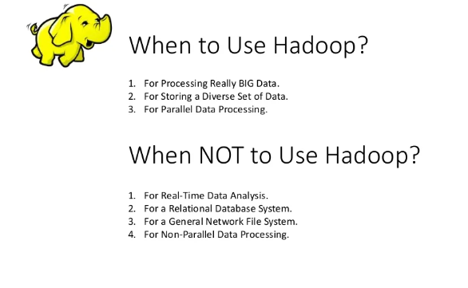

Slide 11
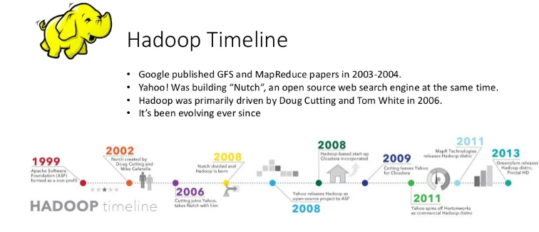

Slide 12
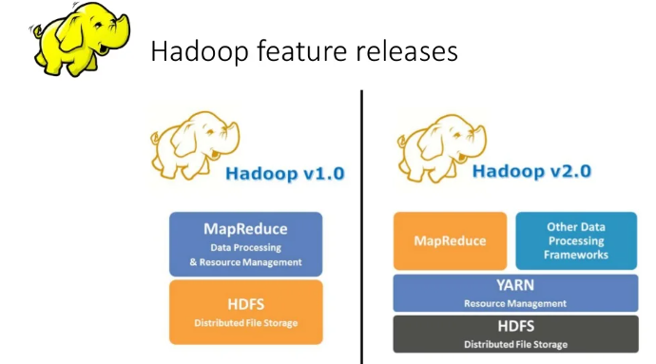

Slide 13
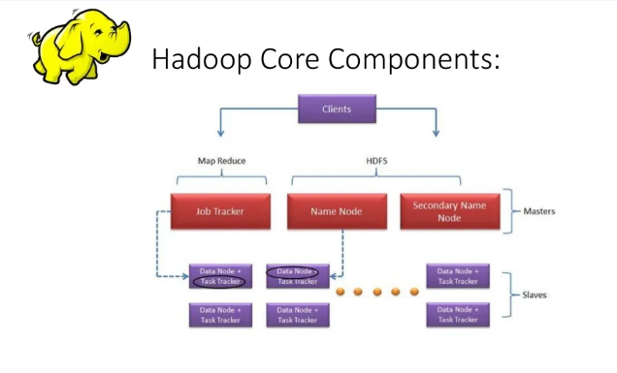

Slide 14
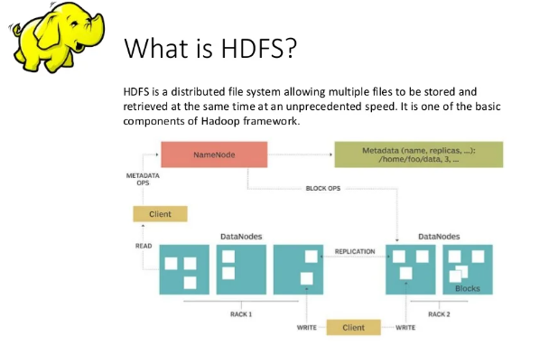

Slide 15
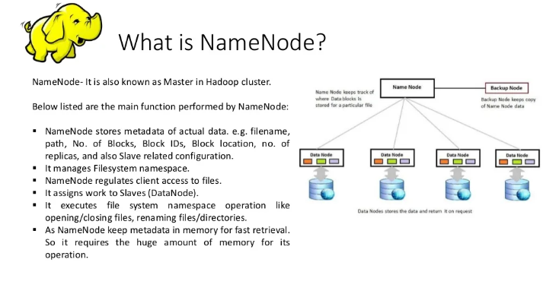

Slide 16
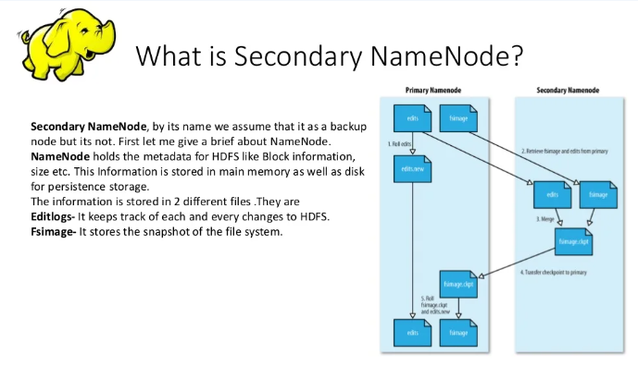

Slide 17
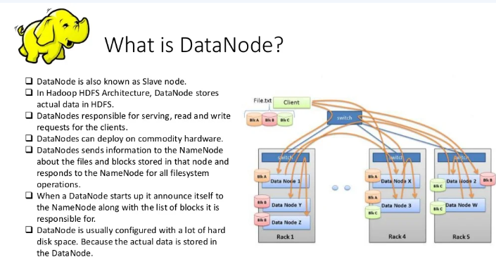

Slide 18
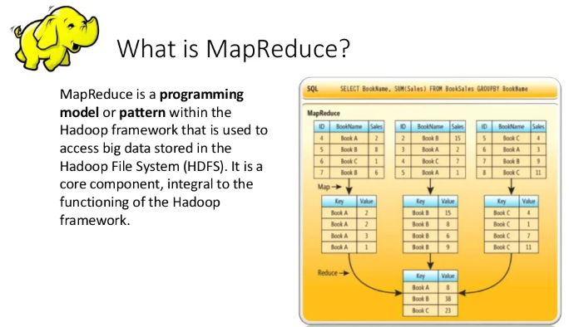

Slide 19
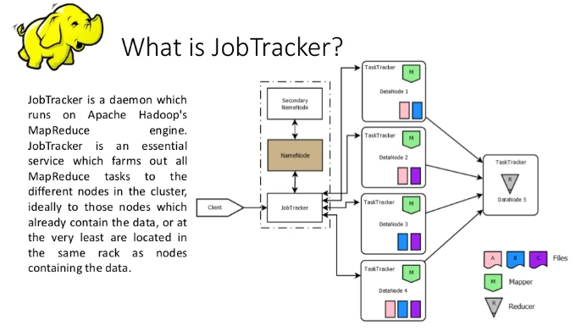

Slide 20
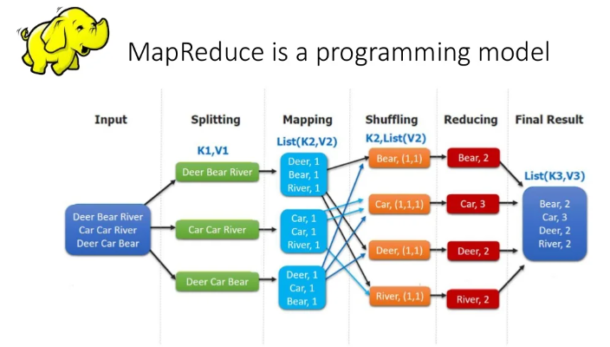

Slide 21
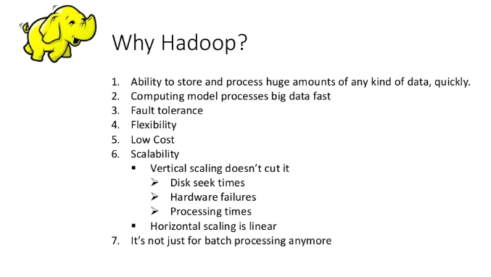

Slide 22
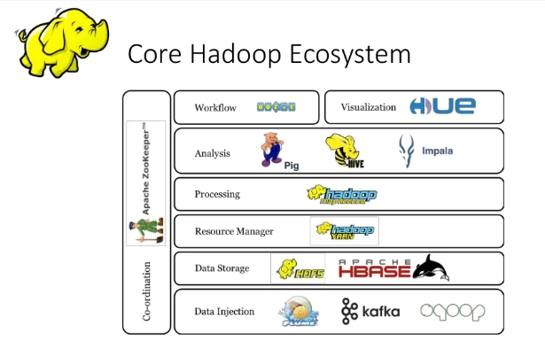

Slide 23
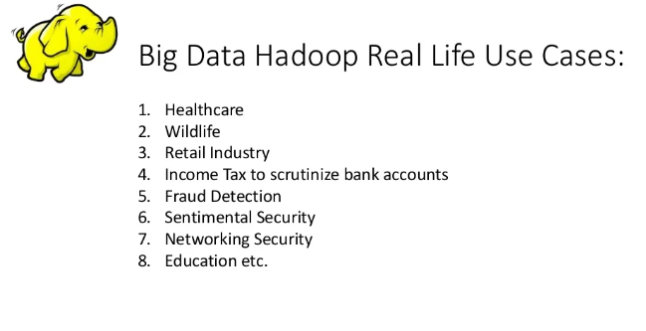

Slide 24
Apache Pig
Apache Pig is a platform for creating programs for Apache Hadoop by using a procedural language known as Pig Latin. Pig is an alternative to Java for creating MapReduce solutions, and it is included with Azure HDInsight.
Load: Read data to be manipulated from the file system.
Transform: Manipulate the data.
Dump or store: Output data to the screen or store it for processing.

Slide 25
Apache Hive
Apache Hive is a data warehouse system for Apache Hadoop. Hive enables data summarization, querying, and analysis of data. Hive queries are written in HiveQL, which is a query language similar to SQL.
Hive allows you to project structure on largely unstructured data. After you define the structure, you can use HiveQL to query the data without knowledge of Java or MapReduce.

Slide 26
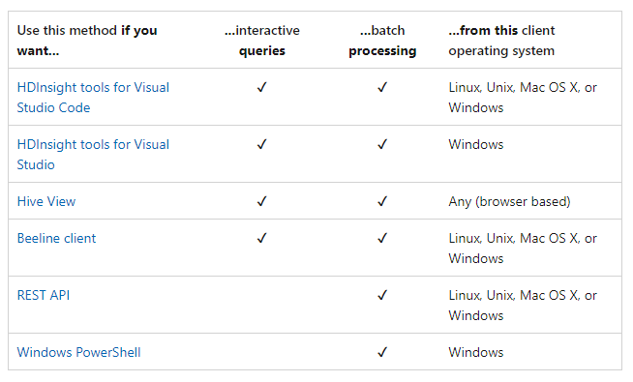
Scenario to use Hive

Slide 27
Apache Kafka
Apache Kafka is an open-source distributed streaming platform that can be used to build real-time streaming data pipelines and applications. Kafka also provides message broker functionality similar to a message queue, where you can publish and subscribe to named data streams.

Slide 28
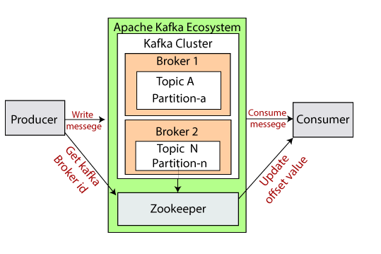
Kafka Ecosystem

Slide 29
Apache Kafka on HDI
It's a managed service that provides a simplified configuration process. The result is a configuration that is tested and supported by Microsoft.
Microsoft provides a 99.9% Service Level Agreement (SLA) on Kafka uptime. For more information, see the SLA information for HDInsight document.
It uses Azure Managed Disks as the backing store for Kafka. Managed Disks can provide up to 16 TB of storage per Kafka broker. For information on configuring managed disks with Kafka on HDInsight, see Increase scalability of Apache Kafka on HDInsight.

Slide 30
Apache Hadoop Deep Dive

Slide 31
HDFS Serialization
Storage formats are a way to define how to store information in the file. Most of the time, assume this information is from the extension of the data. Both structured and unstructured data can store on HADOOP-enabled systems. Common Hdfs file formats are -Plain text storage
Sequence files
RC files
AVRO
Parquet

Slide 32
Why Storage Formats?
File format must be handy to serve complex data structures
HDFS enabled applications to find relevant data in a particular location and write back data to another location.
Dataset is large
Having schemas
Having storage constraints

Slide 33
Data Serialization in HDFS
Data serialization is a process that converts structure data manually back to the original form.
Serialize to translate data structures into a stream of data. Transmit this stream of data over the network or store it in DB regardless of the system architecture.
Isn't storing information in binary form or stream of bytes is the right approach.
Serialization does the same but isn't dependent on architecture.
Consider CSV files contains a comma (,) in between data, so while Deserialization, wrong outputs may occur. Now, if metadata is stored in XML form, a self- architected form of data storage, data can easily deserialize.

Slide 34
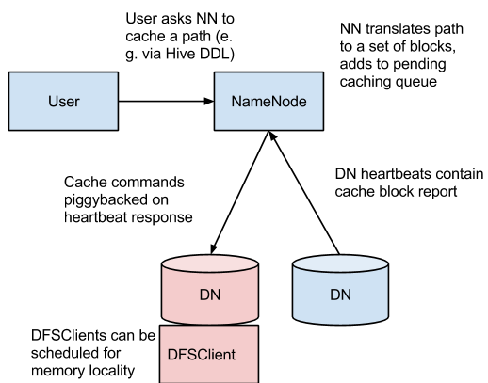
HDFS Caching and Failover
Centralized cache management in HDFS is an explicit caching mechanism that allows users to specify paths to be cached by HDFS.
The NameNode will communicate with DataNodes that have the desired blocks on disk, and instruct them to cache the blocks in off-heap caches.

Slide 35
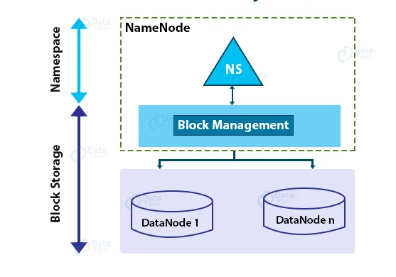
HDFS Federation and HA

Slide 36
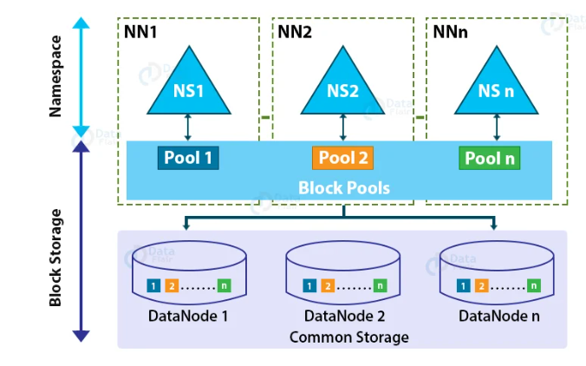
HDFS High Availability

Slide 38
MapReduce Partitioners and Combiners
The sequence of execution of the mentioned components happens in the below order: Mapper -> Combiner -> Partitioner Mapper : The Input data is initially processed by all the Mappers/Map jobs and the intermediate output is created.
Combiner : All the intermediate outputs are optimized by local aggregation before the shuffle/sort phase by the Combiner. The primary goal of Combiners is to save as much bandwidth as possible by minimizing the number of key/value pairs that will be shuffled across the network and provided as input to the Reducer.
Partitioner : In Hadoop, partitioning of the keys of the intermediate map output is controlled by Partitioner. Hash function, is used to derive partition. On the basis of key-value pair each map output is partitioned. Record having same key value goes into the same partition (within each mapper), and then each partition is sent to a Reducer. Partition phase takes place in between mapper and reducer. Default Partitioner (Hash Partitioner) computes a hash value for the key and assigns the partition based on this result

Slide 39
Apache Hive Managed and External table
Managed tables are Hive owned tables where the entire lifecycle of the tables' data are managed and controlled by Hive.
External tables are tables where Hive has loose coupling with the data. All the write operations to the Managed tables are performed using Hive SQL commands.

Slide 40
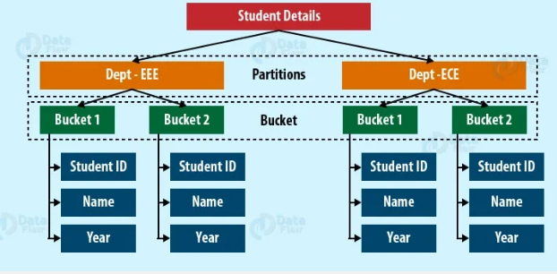
Hive Partitioning and Bucketing
Apache Hive is an open source data warehouse system used for querying and analysing large datasets. Data in Apache Hive can be categorized into Table, Partition, and Bucket.
The table in Hive is logically made up of the data being stored.

Slide 41
Hive Partitioning and Bucketing
Partitioning – Apache Hive organizes tables into partitions for grouping same type of data together based on a column or partition key. Each table in the hive can have one or more partition keys to identify a particular partition. Using partition we can make it faster to do queries on slices of the data.
Bucketing – In Hive Tables or partition are subdivided into buckets based on the hash function of a column in the table to give extra structure to the data that may be used for more efficient queries.

Slide 42
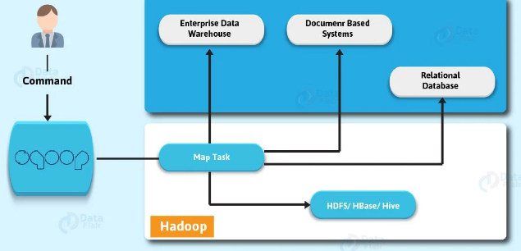
Apache Sqoop
Apache Sqoop is a tool that aims to transfer data between HDFS (Hadoop storage) and relational database servers. Such as MySQL, Oracle RDB, SQLite, Teradata, Netezza, Postgres and many more.
In addition, imports data from relational databases to HDFS. Also, exports data from HDFS to relational databases.

Slide 43
Sqoop Conditional Imports
Sqoop provides an incremental import mode which can be used to retrieve only rows newer than some previously-imported set of rows.

Slide 44

Sqoop File Formats
You can import data in one of two file formats: delimited text or SequenceFiles.
Delimited text is the default import format. You can also specify it explicitly by
using the --as-textfile argument. This argument will write string-based representations of
each record to the output files, with delimiter characters between individual columns and rows.
These delimiters may be commas, tabs, or other characters.
(The delimiters can be selected; see "Output line formatting arguments.")
The following is the results of an example text-based import:

Slide 45
Sqoop File Formats
Delimited text is appropriate for most non-binary data types. It also readily supports further manipulation by other tools, such as Hive.
SequenceFiles are a binary format that store individual records in custom record-specific data types. These data types are manifested as Java classes. Sqoop will automatically generate these data types for you. This format supports exact storage of all data in binary representations, and is appropriate for storing binary data (for example, VARBINARY columns), or data that will be principly manipulated by custom MapReduce programs (reading from SequenceFiles is higher-performance than reading from text files, as records do not need to be parsed).
Avro data files are a compact, efficient binary format that provides interoperability with applications written in other programming languages. Avro also supports versioning, so that when, e.g., columns are added or removed from a table, previously imported data files can be processed along with new ones.

Slide 46
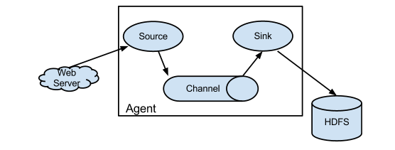
Apache Flume
Flume is a distributed, reliable, and available service for efficiently collecting, aggregating, and moving large amounts of log data. It has a simple and flexible architecture based on streaming data flows.
It is robust and fault tolerant with tunable reliability mechanisms and many failover and recovery mechanisms. It uses a simple extensible data model that allows for online analytic application.

Slide 47
Flume Interceptors
Basically, we can modify/drop events in-flight with the help of Apache Flume. It has the capability. So, this process takes place with the help of interceptors in Flume.
Moreover, they are the classes that implement org.apache.flume.interceptor.Interceptor interface. Also, can modify or even drop events based on any criteria chosen by the developer of the interceptor.
In addition, Apache Flume supports chaining of interceptors. It is only possible through by specifying the list of interceptor builder class names in the configuration. Although, in the source configuration Flume interceptors are specified as a whitespace separated list.

Slide 48
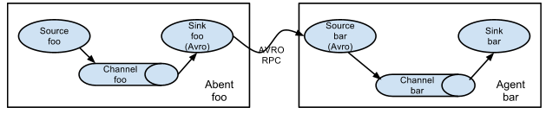
Flume Consolidation and multi-agent flow

Slide 49
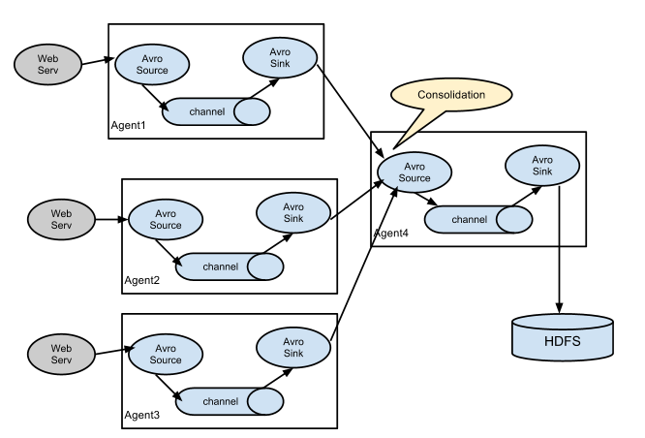
Consolidation

Slide 50
Apache Oozie
Apache Oozie Workflow Scheduler for Hadoop is a workflow and coordination service for managing Apache Hadoop jobs:
Oozie Workflow jobs are Directed Acyclical Graphs (DAGs) of actions; actions are typically Hadoop jobs (MapReduce, Streaming, Pipes, Pig, Hive, Sqoop, etc).
Oozie Coordinator jobs trigger recurrent Workflow jobs based on time (frequency) and data availability.
Oozie Bundle jobs are sets of Coordinator jobs managed as a single job.
Oozie is an extensible, scalable and data-aware service that you can use to orchestrate dependencies among jobs running on Hadoop.

Slide 51
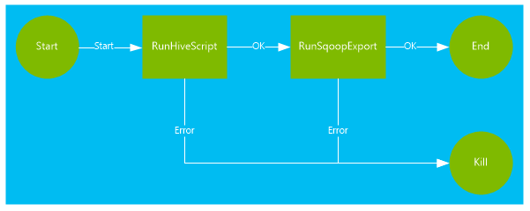
Oozie Workflow

Slide 52
Oozie Bundle
Bundle is a higher-level oozie abstraction that will batch a set of coordinator applications. The user will be able to start/stop/suspend/resume/rerun in the bundle level resulting a better and easy operational control.
More specifically, the oozie Bundle system allows the user to define and execute a bunch of coordinator applications often called a data pipeline. There is no explicit dependency among the coordinator applications in a bundle. However, a user could use the data dependency of coordinator applications to create an implicit data application pipeline.

Slide 53
Submit Oozie job
An Oozie topology runs in a distributed manner, on multiple worker nodes. Storm spreads the tasks evenly on all the worker nodes. The worker node’s role is to listen for jobs and start or stop the processes whenever a new job arrives.
Point to Remember − The workflow and hive scripts should be placed in HDFS path before running the workflow.
oozie job --oozie
http://host_name:8080/oozie -D oozie.wf.application.path=hdfs://namenodepath/pathof_workflow_xml/workflow.xml-run

